Slide 1
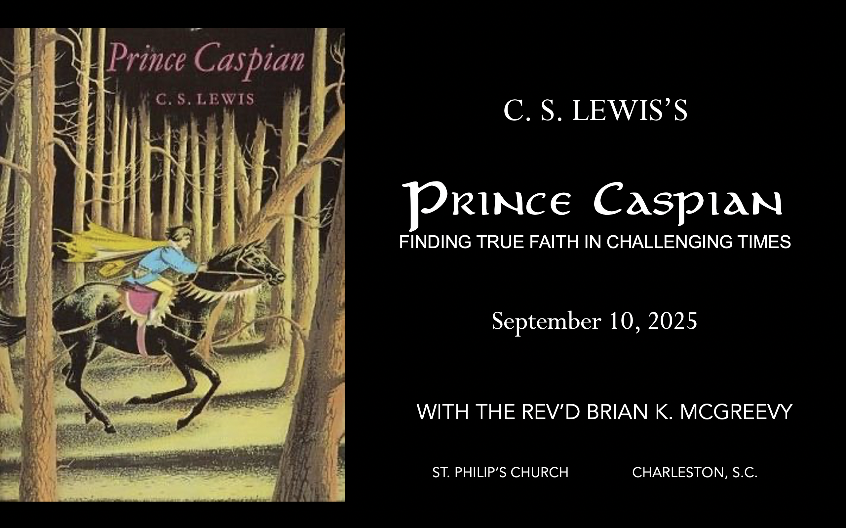


September 24, 2025

Slide 2

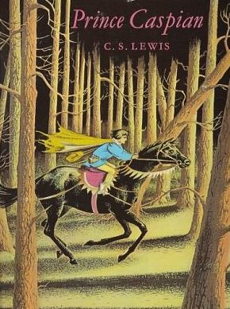
How to approach this class: How to approach this class:
--On the beach --Snorkeling --Scuba diving --Email list/QR code How to read this book: --Try reading aloud and slowly, looking for layers of meaning
--Look for themes/underline and highlight passages that resonate with you
What we’ll be doing:
--Setting the background and context
--Following the story chapter by chapter
--Drawing out principles for living with Joy and Purpose
--Looking at relevant Scripture

Slide 3
For you were once darkness, but now you are light in the Lord. Live as children of light (for the fruit of the light consists in all goodness, righteousness, and truth), and find out what pleases the Lord.
Have nothing to do with the fruitless deeds of darkness, but rather expose them. It is shameful even to mention what the disobedient do in secret. But everything exposed by the light becomes visible—and everything that is illuminated becomes a light. This is why it is said: “Wake up, sleeper, rise from the dead, and Christ will shine on you.” Be very careful, then, how you live— not as unwise but as wise, making the most of every opportunity because the days are evil.
Ephesians 5:8-15

Slide 4
Why Narnia matters SO much today Aggressively secular narrative pervading our culture—how to counter?
Which Story Can We Trust? Either
We are here by accident, meaningless products of a random process. We create our own identity and can only invent meaning and purpose in life and do our best to stay alive—even though there is no point to life. Sartre, Dawkins, Nietzsche, most schools OR
We are precious creatures made by and in the image of a loving God, who has created us for something special that we are asked to do. We have the privilege of being able to do good and experience purpose as we live by faith in Christ in His Kingdom. The witness of Scripture, the Church, and the saints
These two stories are totally incompatible. They can’t both be right: cognitive dissonance. So which do we trust? Other stories, like the Chronicles of Narnia, can help us here by highlighting dissonance or by creating a narrative we want to inhabit. So which do we trust? Is Jadis really the Queen of the realm of Queen Narnia? OR Is she the White Witch, a usurper in Narnia, which is really the realm of the mysterious great and noble lion, Aslan? Gradually, one story about Narnia emerges as supremely plausible, as each individual story turns out to be part of this greater narrative. This grand narrative of interlocking stories makes sense of the riddles the children see and experience and reveals the character of each narrative. These stories teach that Biblical truth and the wisdom of the world cannot both be True---we need to learn to think critically because we are surrounded by falsehood.
We each have our unique story. But our own story needs to be brought into connection with a grand narrative, a big story which gives our story a new importance and significance. Why? Because we realize that our story is framed by something greater which gives us value and purpose. Lewis’s remarkable achievement in Narnia is to allow his readers to inhabit this big story, to get inside it and feel what it is like to be part of it. --Rev. Dr. Alister McGrath, Holder of the Andreas Idreos Chair in Science and Religion, Oxford University (Ph.D. in Molecular Biophysics, Doctor of Divinity in Theology, and Ph.D. in Intellectual History, at Oxford)

Slide 5
Imagination: What Does It Mean to Inhabit a Story
“The shaping of our loves, desires, and imagination thus happens primarily
The Narnia stories are deeply grounded in the Biblical story and its four major scenes of Creation, Fall, Redemption, and New Creation. The White Witch, Miraz, and other evil characters in the Narnia stories are all engaged in the evil enchantment of encouraging a Disciplined Forgetting of Aslan, his Story, and the Deep Magic.
In The Chonicles of Narnia, Lewis wants to show us through Story, experienced through the eyes and experiences and emotions of children, the Truth and Beauty and Goodness of Creation, the horror of the Fall, the immense Love shown in redemption, and the Hope and Joy and Glory of the New Creation, even though it is not yet fully realized but where we see that “Aslan is on the move” (the theological concept of the Now and Not Yet).
Unseen Realities
For this light momentary affliction is preparing for us an eternal weight of glory beyond all comparison, as we look not to the things that are seen but to the things that are unseen. For the things that are seen are transient, but the things that are unseen are eternal.—2 Corinthians 4:17-18

Slide 6
Why Prince Caspian is especially relevant today
Imagine living in a land
--that had forgotten its history and substituted a revisionist narrative that said all evidences of the Divine were foolish myths,
--where individuals struggled to practice their faith while being surrounded by a sea of doubters and skeptics,
--where Evil seemed poised to triumph over Good, and
-- where even the strongest believers wondered sometimes whether they had been abandoned.
Welcome to the world of Prince Caspian, the next book of the Chronicles of Narnia after The Lion, the Witch, and the Wardrobe. C.S. Lewis wrote that this book concerns the “restoration of the true religion after a corruption.
We will be examining such themes as
--how disbelief and doubt creep into our lives,
--the effects of living under the wrong framework of reality,
--the importance of cultivating virtue and courage, and
--the priority of seeking the Kingdom of God with our whole heart.

Slide 7
Chapter 1: “The Island”
(Firing the imagination—what island? There was no island in the previous story. What could this mean?)
Peter, Susan, Edmund, and Lucy are together in a country train station returning back to boarding school when they feel tugged at and realize it’s Magic, so they hold hands and embrace the adventure
They find themselves landed in a thick and silent wood and Lucy immediately wonders if they are back in Narnia; Peter says they might be anywhere
They explore and make their way to a beautiful sandy beach on the sea, have a brief frolic, then realize they need to find water and food, so they set off to search for a stream
In their exploration they determine they are on an island, find a beautiful clear stream, and then in exploring the wood find an apple orchard and an ancient and very high wall
Themes
The call to Narnia/the Kingdom often comes when you do not expect it and aren’t looking for it
There is wisdom in being guided by “the books”
Being proactive, accepting the adventure, and exploring are needful
Keeping alive your capacity for Wonder is important in embracing the call “We know we are being touched by a finger of that right hand at which there are pleasures for evermore. There need be no question of thanks or praise as a separate event, something done afterwards. To experience the tiny theophany is itself to adore.“Gratitude exclaims, very properly, “How good of God to give me this.” Adoration says: “What must be the quality of that Being whose far-off and momentary coruscations are like this!” One’s mind runs back up the sunbeam to the sun.”—from Lewis’s Letters to Malcolm: Chiefly on Prayer

Slide 8
Chapter 2: “The Ancient Treasure House”
(Firing the imagination—TREASURE!? What treasure? Whose treasure? What could this mean?)
Peter, Susan, Edmund, and Lucy explore the ruins of the castle on the island and build a fire, wondering where they are, until Susan finds a golden chess piece and they are flooded with memories
Peter announces they must be in Cair Paravel and then sets out the reasons why, though it seems impossible time-wise
Lucy says if it is Cair Paravel, there ought to be a door in the ivy-covered wall behind them that leads to the treasure chamber
They find the door, enter the darkness, and know for certain they are back in Narnia, enthralled by seeing their old treasures and especially Aslan’s Christmas gifts, minus Susan’s horn
Themes
The power and poignancy of remembering
The importance of logical, factual reasoning, especially when we don’t understand
Knowing your true identity is necessary in order to have courage and embrace your calling
The bittersweet Joy of sehnsucht/longing

Slide 9
Peter, Susan, Edmund, and Lucy explore the ruins of the castle and build a fire, wondering where they are, until Susan finds a golden chess piece and they are flooded with memories
“This wasn't a garden," said Susan presently. "It was a castle and this must have been the courtyard." "I see what you mean," said Peter. "Yes. That is the remains of a tower. And there is what used to be a flight of steps going up to the top of the walls. And look at those other steps — the broad, shallow ones — going up to that doorway. It must have been the door into the great hall." "Ages ago, by the look of it," said Edmund. "Yes, ages ago," said Peter. "I wish we could find out who the people were that lived in this castle; and how long ago." "It gives me a queer feeling," said Lucy. "Does it, Lu?" said Peter, turning and looking hard at her. "Because it does the same to me. It is the queerest thing that has happened this queer day. I wonder where we are and what it all means?" While they were talking they had crossed the courtyard and gone through the other doorway into what had once been the hall. This was now very like the courtyard, for the roof had long since disappeared and it was merely another space of grass and daisies, except that it was shorter and narrower and the walls were higher…[For supper] they had to content themselves with raw apples, which, as Edmund said, made one realize that school suppers weren't so bad after all — "I shouldn't mind a good thick slice of bread and margarine this minute," he added. But the spirit of adventure was rising in them all, and no one really wanted to be back at school. Shortly after the last apple had been eaten, Susan went out to the well to get another drink. When she came back she was carrying something in her hand. "Look," she said in a rather choking kind of voice. "I found it by the well." She handed it to Peter and sat down. The others thought she looked and sounded as if she might be going to cry. Edmund and Lucy eagerly bent forward to see what was in Peter's hand — a little, bright thing that gleamed in the firelight. "Well, I'm — I'm jiggered," said Peter, and his voice also sounded queer. Then he handed it to the others. All now saw what it was — a little chess-knight, ordinary in size but extraordinarily heavy because it was made of pure gold; and the eyes in the horse's head were two tiny little rubies or rather one was, for the other had been knocked out. "Why!" said Lucy, "it's exactly like one of the golden chessmen we used to play with when we were Kings and Queens at Cair Paravel.”

Slide 10
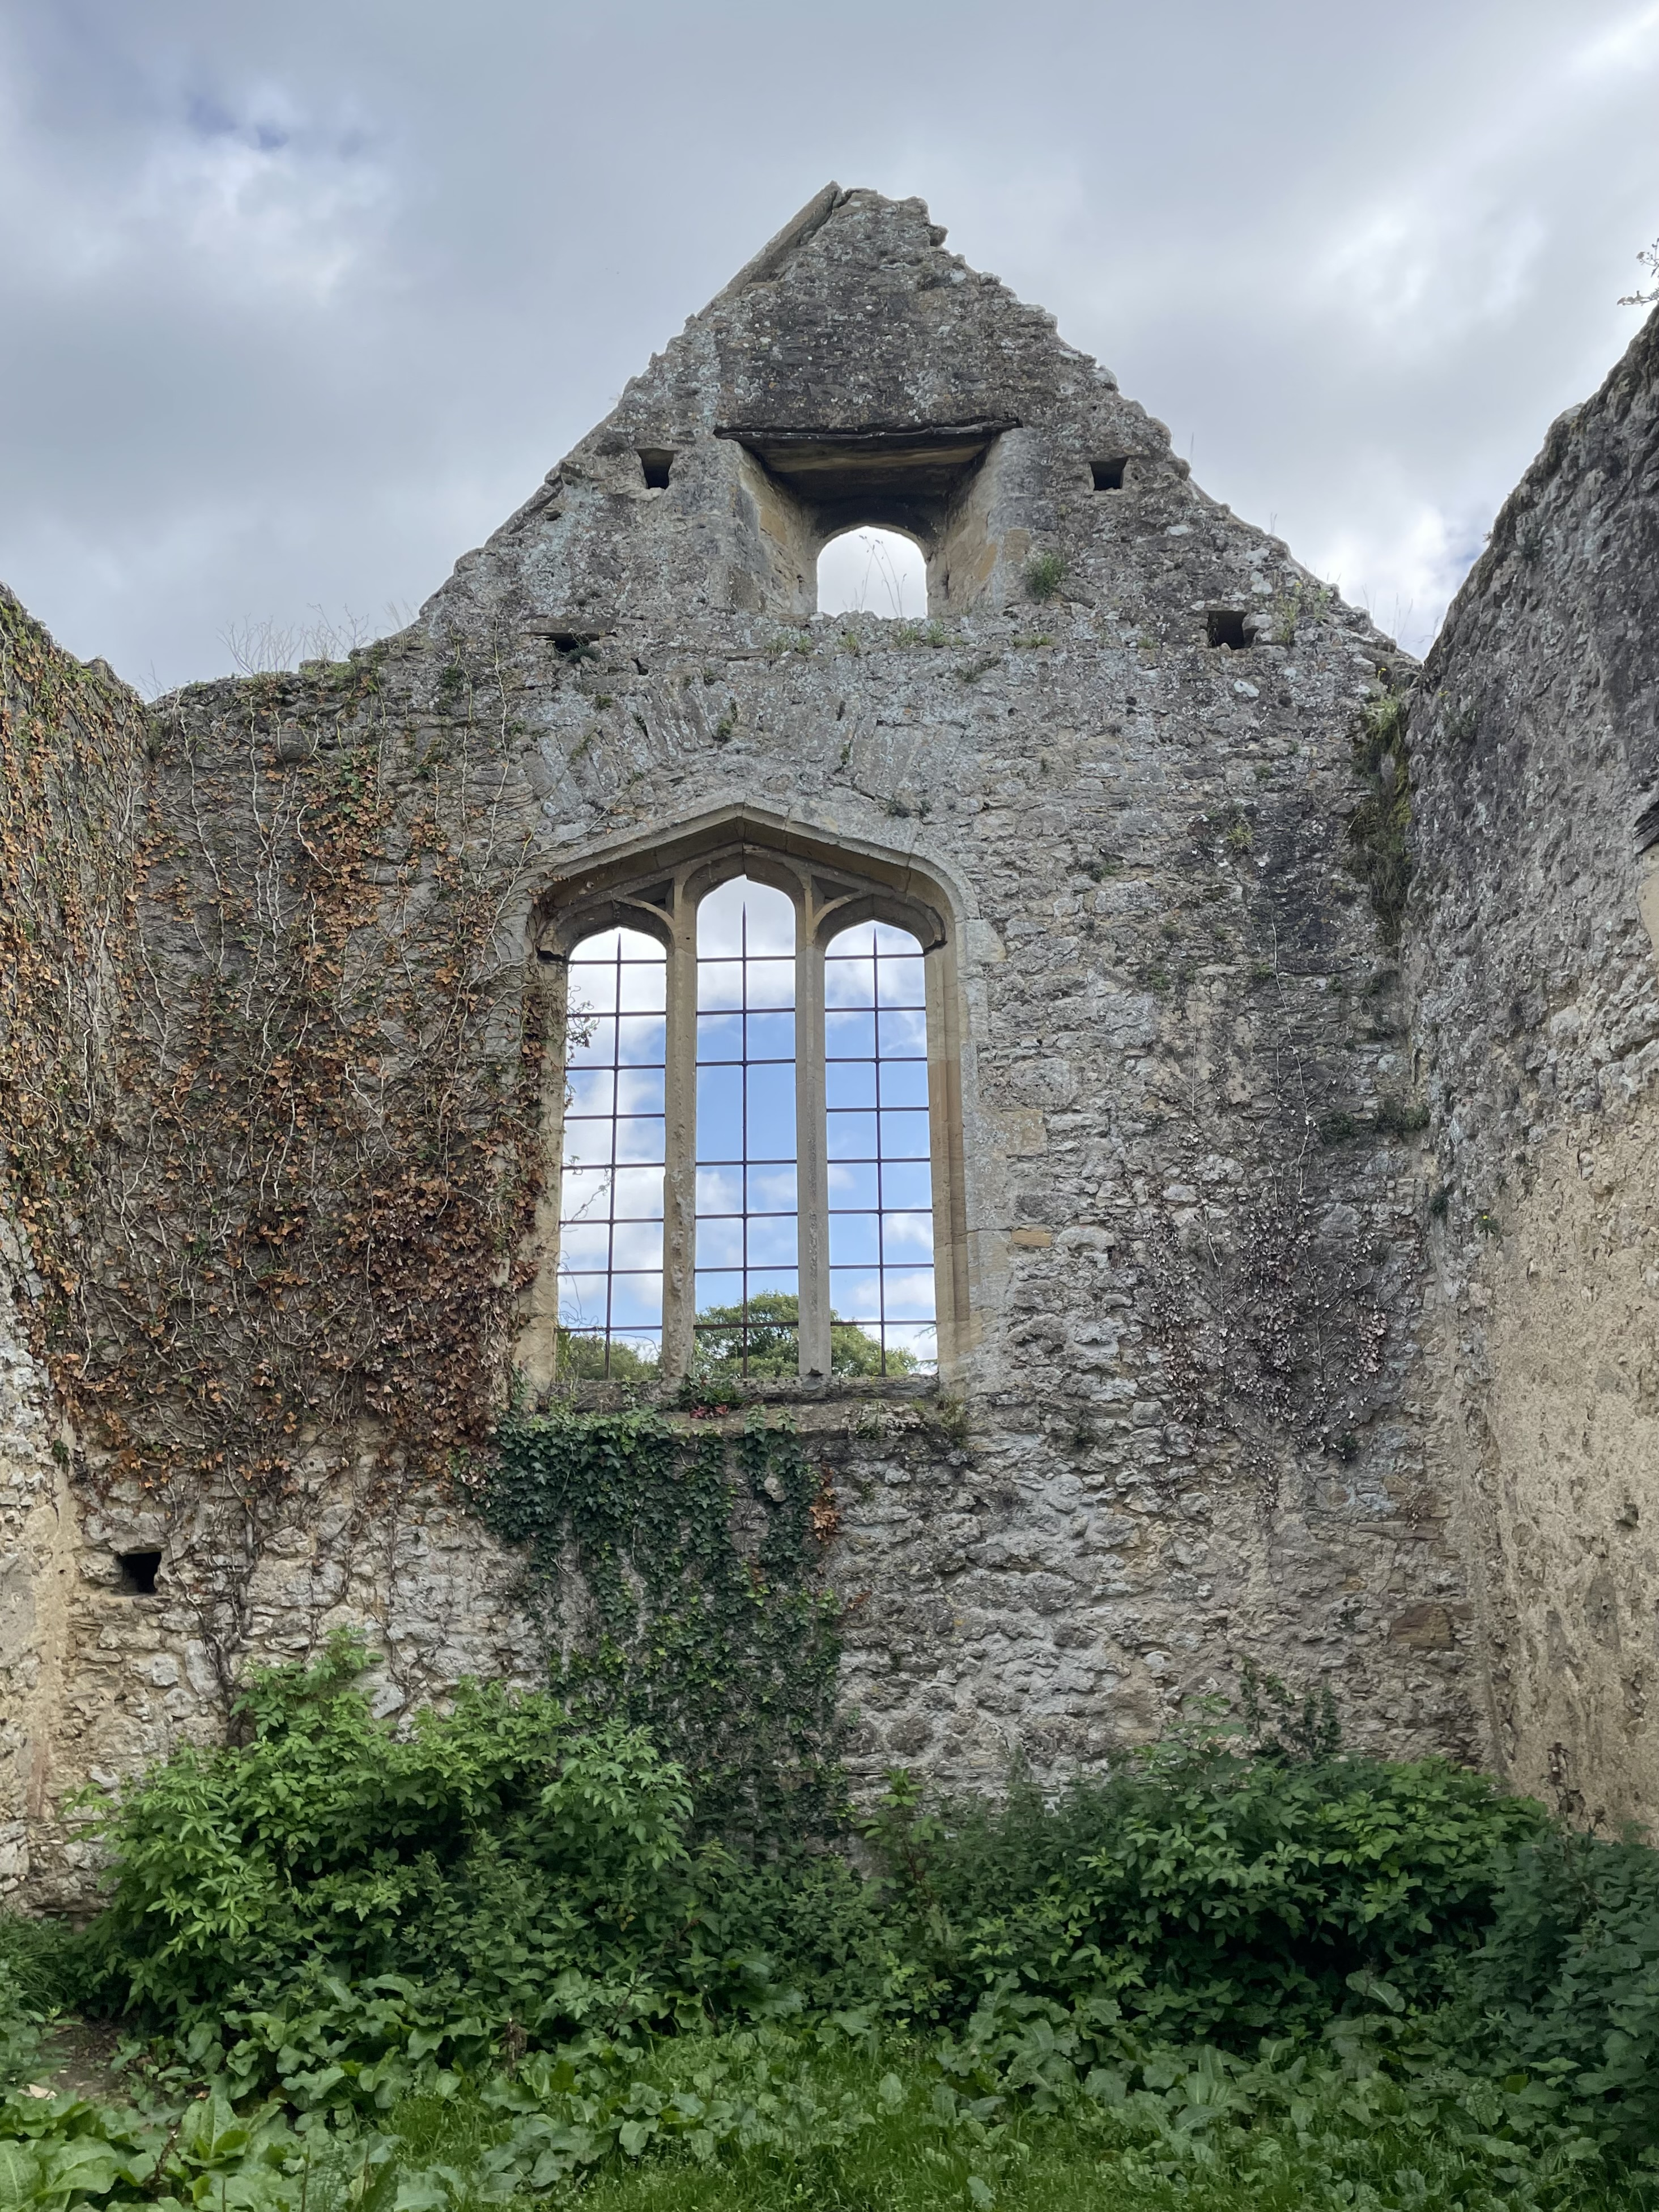
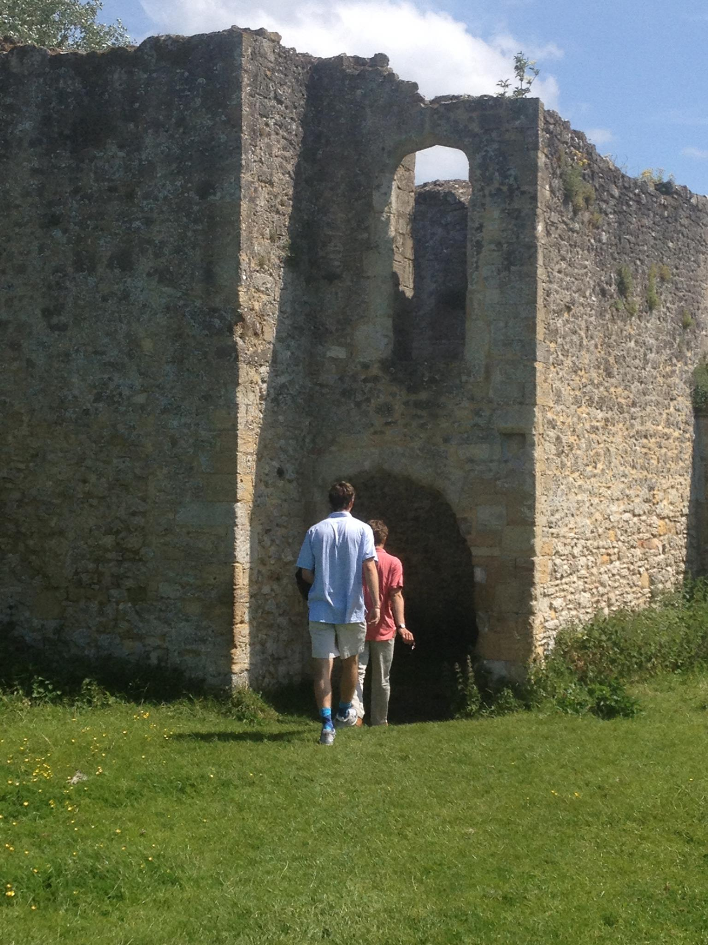
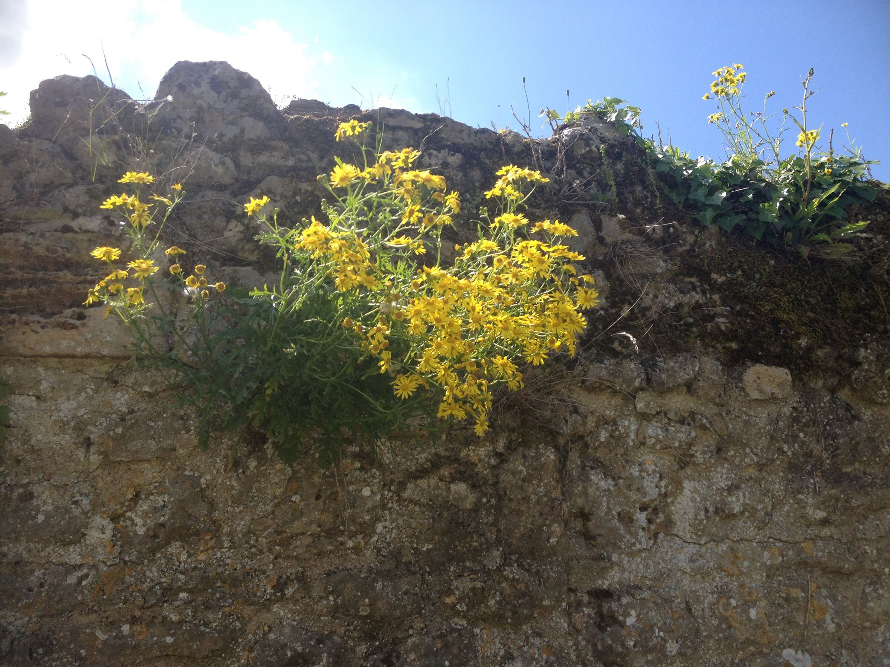
Ruins of Godstow Abbey (12th century) on one of Lewis’s favorite walking routes in Oxford

Slide 11
Peter announces they must be in Cair Paravel and then sets out the reasons why, though it seems impossible time-wise
"Now," said Peter in a quite different voice, "it's about time we four started using our brains." "What about?" asked Edmund. "Have none of you guessed where we are?" said Peter. "Go on, go on," said Lucy. "I've felt for hours that there was some wonderful mystery hanging over this place." "Fire ahead, Peter," said Edmund. "We're all listening." "We are in the ruins of Cair Paravel itself," said Peter. "But, I say," replied Edmund. "I mean, how do you make that out? This place has been ruined for ages. Look at all those big trees growing right up to the gates. Look at the very stones. Anyone can see that nobody has lived here for hundreds of years." "I know," said Peter. "That is the difficulty. But let's leave that out for the moment. I want to take the points one by one. First point: this hall is exactly the same shape and size as the hall at Cair Paravel. Just picture a roof on this, and a coloured pavement instead of grass, and tapestries on the walls, and you get our royal banqueting hall." No one said anything. "Second point," continued Peter. "The castle well is exactly where our well was, a little to the south of the great hall; and it is exactly the same size and shape." Again there was no reply. "Third point: Susan has just found one of our old chessmen — or something as like one of them as two peas." Still nobody answered. "Fourth point. Don't you remember — it was the very day before the ambassadors came from the King of Calormen don't you remember planting the orchard outside the north gate of Cair Paravel? The greatest of all the wood-people, Pomona herself, came to put good spells on it. It was those very decent little chaps the moles who did the actual digging. Can you have forgotten that funny old Lilygloves, the chief mole, leaning on his spade and saying, `Believe me, your Majesty, you'll be glad of these fruit trees one day.' And by Jove he was right."

Slide 12
They find the door, enter the darkness with a flashlight, and seeing the chamber know for certain they are back in Narnia, enthralled by the sight of their old treasures and especially Aslan’s Christmas gifts, minus Susan’s horn
"One — two — three," said Edmund, as he went cautiously down, and so up to sixteen. "And this is the bottom," he shouted back. "Then it really must be Cair Paravel," said Lucy. "There were sixteen." Nothing more was said till all four were standing in a knot together at the foot of the stairway. Then Edmund flashed his torch slowly round. "O — o — o — oh!!" said all the children at once. For now all knew that it was indeed the ancient treasure chamber of Cair Paravel where they had once reigned as Kings and Queens of Narnia. There was a kind of path up the middle (as it might be in a greenhouse), and along each side at intervals stood rich suits of armour, like knights guarding the treasures. In between the suits of armour, and on each side of the path, were shelves covered with precious things — necklaces and arm rings and finger rings and golden bowls and dishes and long tusks of ivory, brooches and coronets and chains of gold, and heaps of unset stones lying piled anyhow as if they were marbles or potatoes — diamonds, rubies, carbuncles, emeralds, topazes, and amethysts…There was something sad and a little frightening about the place, because it all seemed so forsaken and long ago. That was why nobody said anything for at least a minute. Then, of course, they began walking about and picking things up to look at. It was like meeting very old friends. If you had been there you would have heard them saying things like, "Oh look! Our coronation rings — do you remember first wearing this? — Why, this is the little brooch we all thought was lost — I say, isn't that the armour you wore in the great tournament in the Lone Islands? — do you remember the dwarf making that for me? — do you remember drinking out of that horn? — do you remember, do you remember?" But suddenly Edmund said, "Look here. We mustn't waste the battery: goodness knows how often we shall need it. Hadn't we better take what we want and get out again?" "We must take the gifts," said Peter. For long ago at a Christmas in Narnia he and Susan and Lucy had been given certain presents which they valued more than their whole kingdom. Edmund had had no gift, because he was not with them at the time. (This was his own fault, and you can read about it in the other book.) They all agreed with Peter and walked up the path to the wall at the far end of the

Slide 13
treasure chamber, and there, sure enough, the gifts were still hanging. Lucy's was the smallest for it was only a little bottle. But the bottle was made of diamond instead of glass, and it was still more than half full of the magical cordial which would heal almost every wound and every illness. Lucy said nothing and looked very solemn as she took her gift down from its place and slung the belt over her shoulder and once more felt the bottle at her side where it used to hang in the old days. Susan's gift had been a bow and arrows and a horn. The bow was still there, and the ivory quiver, full of wellfeathered arrows, but — "Oh, Susan," said Lucy. "Where's the horn?"
"Oh bother, bother, bother," said Susan after she had thought for a moment. "I remember now. I took it with me the last day of all, the day we went hunting the White Stag. It must have got lost when we blundered back into that other place — England, I mean." Edmund whistled. It was indeed a shattering loss; for this was an enchanted horn and, whenever you blew it, help was certain to come to you, wherever you were. "Just the sort of thing that might come in handy in a place like this," said Edmund. "Never mind," said Susan, "I've still got the bow." And she took it. "Won't the string be perished, Su?" said Peter. But whether by some magic in the air of the treasure chamber or not, the bow was still in working order. In a moment she had bent the bow and then she gave one little pluck to the string. It twanged: a chirruping twang that vibrated through the whole room. And that one small noise brought back the old days to the children's minds more than anything that had happened yet. All the battles and hunts and feasts came rushing into their heads together. Then she unstrung the bow again and slung the quiver at her side. Next, Peter took down his gift — the shield with the great red lion on it, and the royal sword. He blew, and rapped them on the floor, to get off the dust. He fitted the shield on his arm and slung the sword by his side. He was afraid at first that it might be rusty and stick to the sheath. But it was not so. With one swift motion he drew it and held it up, shining in the torchlight. "It is my sword Rhindon," he said; "with it I killed the Wolf." There was a new tone in his voice, and the others all felt that he was really Peter the High King again.”

Slide 14
Themes The power and poignancy of remembering "Look," she said in a rather choking kind of voice. "I found it by the well." She handed it to Peter and sat down. The others thought she looked and sounded as if she might be going to cry. Edmund and Lucy eagerly bent forward to see what was in Peter's hand — a little, bright thing that gleamed in the firelight. "Why!" said Lucy, "it's exactly like one of the golden chessmen we used to play with when we were Kings and Queens at Cair Paravel." "Cheer up, Su," said Peter to his other sister. "I can't help it," said Susan. "It brought back — oh, such lovely times. And I remembered playing chess with fauns and good giants, and the mer-people singing in the sea, and my beautiful horse — and — and”…There was something sad and a little frightening about the place, because it all seemed so forsaken and long ago. That was why nobody said anything for at least a minute. Then, of course, they began walking about and picking things up to look at. It was like meeting very old friends. If you had been there you would have heard them saying things like, "Oh look! Our coronation rings — do you remember first wearing this? — Why, this is the little brooch we all thought was lost — I say, isn't that the armour you wore in the great tournament in the Lone Islands? — do you remember the dwarf making that for me? — do you remember drinking out of that horn? — do you remember, do you remember?” These things I remember, as I pour out my soul: how I would go with the throng and lead them in procession to the house of God with glad shouts and songs of praise, a multitude keeping festival. (Ps. 42:4) By the rivers of Babylon we sat and wept when we remembered Zion. There on the poplars we hung our harps, for there our captors asked us for songs, our tormentors demanded songs of joy; they said, “Sing us one of the songs of Zion!” How can we sing the songs of the Lord while in a foreign land? (Ps. 137:1-4) Remember those earlier days after you had received the light, when you endured in a great conflict full of suffering. Sometimes you were publicly exposed to insult and persecution; at other times you stood side by side with those who were so treated. You suffered along with those in prison and joyfully accepted the confiscation of your property, because you knew that you yourselves had better and lasting possessions. (Hebrews 10:32-34) Remember how the Lord your God led you all the way in the wilderness these forty years, to humble and test you in order to know what was in your heart, whether or not you would keep his commands. Deut. 8:2

Slide 15
The importance of logical, factual reasoning, especially when we don’t understand
“Now," said Peter in a quite different voice, "it's about time we four started using our brains." "What about?" asked Edmund. "Have none of you guessed where we are?" said Peter. "Go on, go on," said Lucy. "I've felt for hours that there was some wonderful mystery hanging over this place." "Fire ahead, Peter," said Edmund. "We're all listening." "We are in the ruins of Cair Paravel itself," said Peter. "But, I say," replied Edmund. "I mean, how do you make that out? This place has been ruined for ages. Look at all those big trees growing right up to the gates. Look at the very stones. Anyone can see that nobody has lived here for hundreds of years." "I know," said Peter. "That is the difficulty. But let's leave that out for the moment. I want to take the points one by one. First point: this hall is exactly the same shape and size as the hall at Cair Paravel. Just picture a roof on this, and a coloured pavement instead of grass, and tapestries on the walls, and you get our royal banqueting hall." No one said anything. "Second point," continued Peter. "The castle well is exactly where our well was, a little to the south of the great hall; and it is exactly the same size and shape." Again there was no reply. "Third point: Susan has just found one of our old chessmen — or something as like one of them as two peas." Still nobody answered. "Fourth point. Don't you remember — it was the very day before the ambassadors came from the King of Calormen don't you remember planting the orchard outside the north gate of Cair Paravel? The greatest of all the wood-people, Pomona herself, came to put good spells on it. It was those very decent little chaps the moles who did the actual digging.” Come now, let us reason together, says the LORD Is. 1:18 Then Paul, as his custom was, went in to them, and for three Sabbaths reasoned with them from the Scriptures Acts 17:2 Think over what I say, for the Lord will give you understanding in everything. 2 Timothy 2:7 For which of you, desiring to build a tower, does not first sit down and count the cost, whether he has enough to complete it? Luke 14:28You shall love the Lord your God with all your heart, and with all your soul, and with all your mind Mt. 22:37

Slide 16
Knowing your true identity and gifts is needed in order to have courage and embrace your calling
"Oh, what is the good?" said Susan. "And as Edmund said…” "I'm not saying it now," Edmund interrupted. "I still don't understand, but we can settle that later. I suppose you're coming down, Peter?" "We must," said Peter. "Cheer up, Susan. It's no good behaving like kids now that we are back in Narnia. You're a Queen here. And anyway no one could go to sleep with a mystery like this on their minds.” Next, Peter took down his gift — the shield with the great red lion on it, and the royal sword. He blew, and rapped them on the floor, to get off the dust. He fitted the shield on his arm and slung the sword by his side. He was afraid at first that it might be rusty and stick to the sheath. But it was not so. With one swift motion he drew it and held it up, shining in the torchlight. "It is my sword Rhindon," he said; "with it I killed the Wolf." There was a new tone in his voice, and the others all felt that he was really Peter the High King again.”
But you are a chosen people, a royal priesthood, a holy nation, God’s special possession, that you may declare the praises of him who called you out of darkness into his wonderful light. Once you were not a people, but now you are the people of God; once you had not received mercy, but now you have received mercy. I Peter 2:9-10 For you created my inmost being; you knit me together in my mother’s womb. I praise you because I am fearfully and wonderfully made; your works are wonderful, I know that full well. Ps. 139:13-14 For by the grace given me I say to every one of you: Do not think of yourself more highly than you ought, but rather think of yourself with sober judgment, in accordance with the faith God has distributed to each of you. For just as each of us has one body with many members, and these members do not all have the same function, so in Christ we, though many, form one body, and each member belongs to all the others. We have different gifts, according to the grace given to each of us. Rom. 12:3-6

Slide 17
The bittersweet Joy of sehnsucht/longing
"Why, you silly," said Peter (who had become strangely excited), "don't you see? That was the dais where the High Table was, where the King and the great lords sat. Anyone would think you had forgotten that we ourselves were once Kings and Queens and sat on a dais just like that, in our great hall." "In our castle of Cair Paravel," continued Susan in a dreamy and rather sing-song voice, "at the mouth of the great river of Narnia. How could I forget?" "How it all comes back!" said Lucy. "We could pretend we were in Cair Paravel now. This hall must have been very like the great hall we feasted in." "But unfortunately without the feast," said Edmund. ”…"Cheer up, Su," said Peter to his other sister. "I can't help it," said Susan. "It brought back — oh, such lovely times. And I remembered playing chess with fauns and good giants, and the mer-people singing in the sea, and my beautiful horse — and — and —" “[The string of the bow] twanged: a chirruping twang that vibrated through the whole room. And that one small noise brought back the old days to the children's minds more than anything that had happened yet. All the battles and hunts and feasts came rushing into their heads together.” How lovely is your dwelling place, O Lord of hosts! My soul longs, yes, faints for the courts of the Lord; my heart and flesh sing for joy to the living God! Ps. 84:1 We know that the whole creation has been groaning as in the pains of childbirth right up to the present time. Not only so, but we ourselves, who have the firstfruits of the Spirit, groan inwardly as we wait eagerly for our adoption to sonship, the redemption of our bodies. For in this hope we were saved. But hope that is seen is no hope at all. Who hopes for what they already have?he living God. Rom. 8:22-24 Instead, they were longing for a better country—a heavenly one. Therefore God is not ashamed to be called their God, for he has prepared a city for them. Heb. 11:10

Slide 18
DEEPER DIVE: MYTH AND LONGING
In his autobiography Surprised by Joy, Lewis describes his first profound encounters with longing as a nine-year-old. Lewis was fascinated by Myth, particularly Norse myth, and recounts this story from boyhood:
“It is difficult to find words strong enough for the sensation which came over me; Milton's "enormous bliss" of Eden (giving the full, ancient meaning to "enormous") comes somewhere near it. It was a sensation, of course, of desire; but desire for what?...The glimpse [of desire/longing] came through poetry. I had become fond of Longfellow's Saga of King Olaf: fond of it in a casual, shallow way for its story and its vigorous rhythms. But then, and quite different from such pleasures, and like a voice from far more distant regions, there came a moment when I idly turned the pages of the book and found the unrhymed translation of Tegner's Drapa and read I heard a voice that cried, Balder the beautiful Is dead, is dead I knew nothing about Balder; but instantly I was uplifted into huge regions of northern sky, I desired with almost sickening intensity something never to be described (except that it is cold, spacious, severe, pale, and remote) and then, as in the other examples, found myself at the very same moment already falling out of that desire and wishing I were back in it… In a sense the central story of my life is about nothing else.”
On September 13, 1931, six years into his career at Oxford as a Fellow of Magdalen College, Lewis took a late-night walk with friends J.R.R. Tolkien and Hugo Dyson that led to his conversion to Christianity. Writing to his friend Arthur Greeves, he describes what happened: “We began (in Addison’s Walk just after dinner) on metaphor and myth—interrupted by a rush of wind which came so suddenly on the still, warm evening and sent so many leaves pattering down that we thought it was raining. We all held our breath, the other two appreciating the ecstasy of such a thing.” Now what Dyson and Tolkien showed me was this, that if I met the idea of sacrifice in a Pagan story I didn’t mind it at all: again, that if I met the idea of a god sacrificing himself to himself I liked it very much and was mysteriously moved by it: again that the idea of the dying and reviving god (Balder, Adonis,

Slide 19
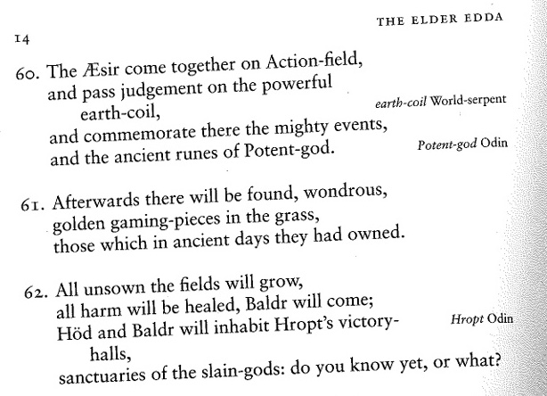
Bacchus) similarly moved me provided I met it anywhere except the Gospels. The reason was that in Pagan stories I was prepared to feel the Myth as profound and suggestive of meanings beyond my grasp even tho’ I could not say in cold prose ‘what it meant’. Now the story of Christ is simply a true myth: a myth working on us in the same way as the others, but with this tremendous difference that it really happened: and one must be content to accept it in the same way, remembering that it is God’s myth where the others are men’s myths.”
Lewis continued to pursue his and Tolkien’s mutual fascination with Norse myth at Oxford, particularly the Edda, a 13th century medieval recounting in Old Icelandic of 10th century Norse tales that include what appear to be some Christian references. Lewis and Tolkien formed the Coalbiters Club (from Icelandic term for an idle youth sitting always by the fireside) where they read these tales aloud in the original language. In theVöluspá section of the Edda, the myth recounts how out of the ashes of death and destruction a glorious and beautiful new world will arise where Balder the Beautiful is brought back to life and a new heaven and earth will be filled with life. Clearly this section has echoes of Christ’s Resurrection and of Revelation 21. One of the symbols of this renewal in this new creation is recounted in this stanza:
Note stanza 61: “Afterwards there will be found, wondrous, golden gaming pieces in the grass, those which in ancient days they had owned”
This stanza is describing when all is put right when
the world is reborn and Evil vanquished and the true
Kings return. Note that Lewis uses this EXACT image when Susan finds the golden chess piece in the grass, and remember Lewis’s saying that Prince Caspian is about “the Restoration of the true religion after a corruption.” This little detail brings into Narnia the whole whole imagery of longing from this Norse myth.
(hat tip to Prof. Simon Horobin for this insight)

Slide 20
TEGNÉR'S DRAPA
I heard a voice, that cried, "Balder the Beautiful Is dead, is dead!" And through the misty air Passed like the mournful cry Of sunward sailing cranes. I saw the pallid corpse Of the dead sun Borne through the Northern sky. Blasts from Niffelheim Lifted the sheeted mists Around him as he passed. And the voice forever cried, "Balder the Beautiful Is dead, is dead!" And died away Through the dreary night, In accents of despair. Balder the Beautiful, God of the summer sun, Fairest of all the Gods! Light from his forehead beamed, Runes were upon his tongue, As on the warrior's sword.
All things in earth and air Bound were by magic spell Never to do him harm; Even the plants and stones; All save the mistletoe, The sacred mistletoe! Hoeder, the blind old God, Whose feet are shod with silence, Pierced through that gentle breast With his sharp spear, by fraud Made of the mistletoe, The accursed mistletoe! They laid him in his ship, With horse and harness, As on a funeral pyre. Odin placed A ring upon his finger, And whispered in his ear. They launched the burning ship! It floated far away Over the misty sea, Till like the sun it seemed, Sinking beneath the waves. Balder returned no more!
So perish the old Gods! But out of the sea of Time Rises a new land of song, Fairer than the old. Over its meadows green Walk the young bards and sing. Build it again, O ye bards, Fairer than before! Ye fathers of the new race, Feed upon morning dew, Sing the new Song of Love! The law of force is dead! The law of love prevails! Thor, the thunderer, Shall rule the earth no more, No more, with threats, Challenge the meek Christ. Sing no more, O ye bards of the North, Of Vikings and of Jarls! Of the days of Eld Preserve the freedom only, Not the deeds of blood! --Henry W. Longfellow, 1850

Slide 21
And I Saw
And I saw a new heaven and a new earth: for the first heaven and the first earth were passed away; and there was no more sea.
And I John saw the holy city, new Jerusalem, coming down from God out of heaven, prepared as a bride adorned for her husband.
And I heard a great voice out of Heaven, saying, Behold, the tabernacle of God is with men, and he will dwell with them, and they shall be his people, and God himself shall be with them, and be their God.
And God shall wipe away all tears from their eyes; and there shall be no more death, neither sorrow, nor crying, neither shall there be any more pain: for the former things are passed away.
Text: Revelation 21
Music: Edgar Bainton (1928)

